Slide 1
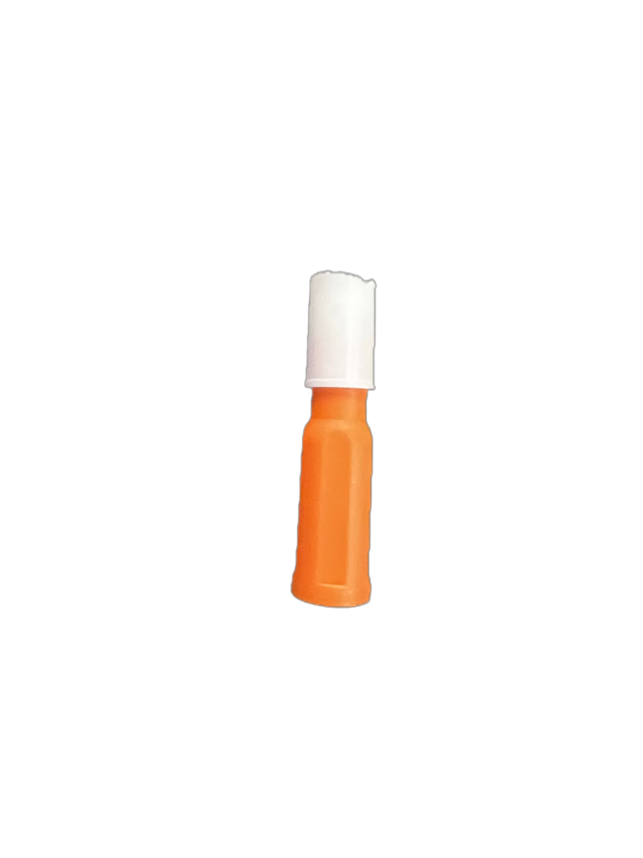
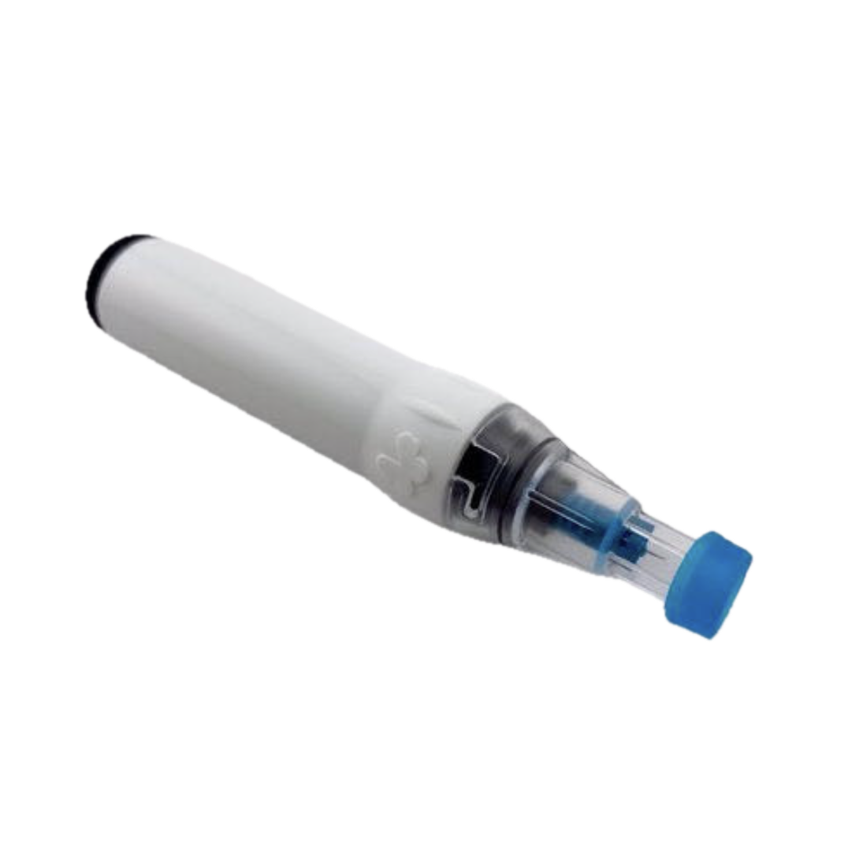
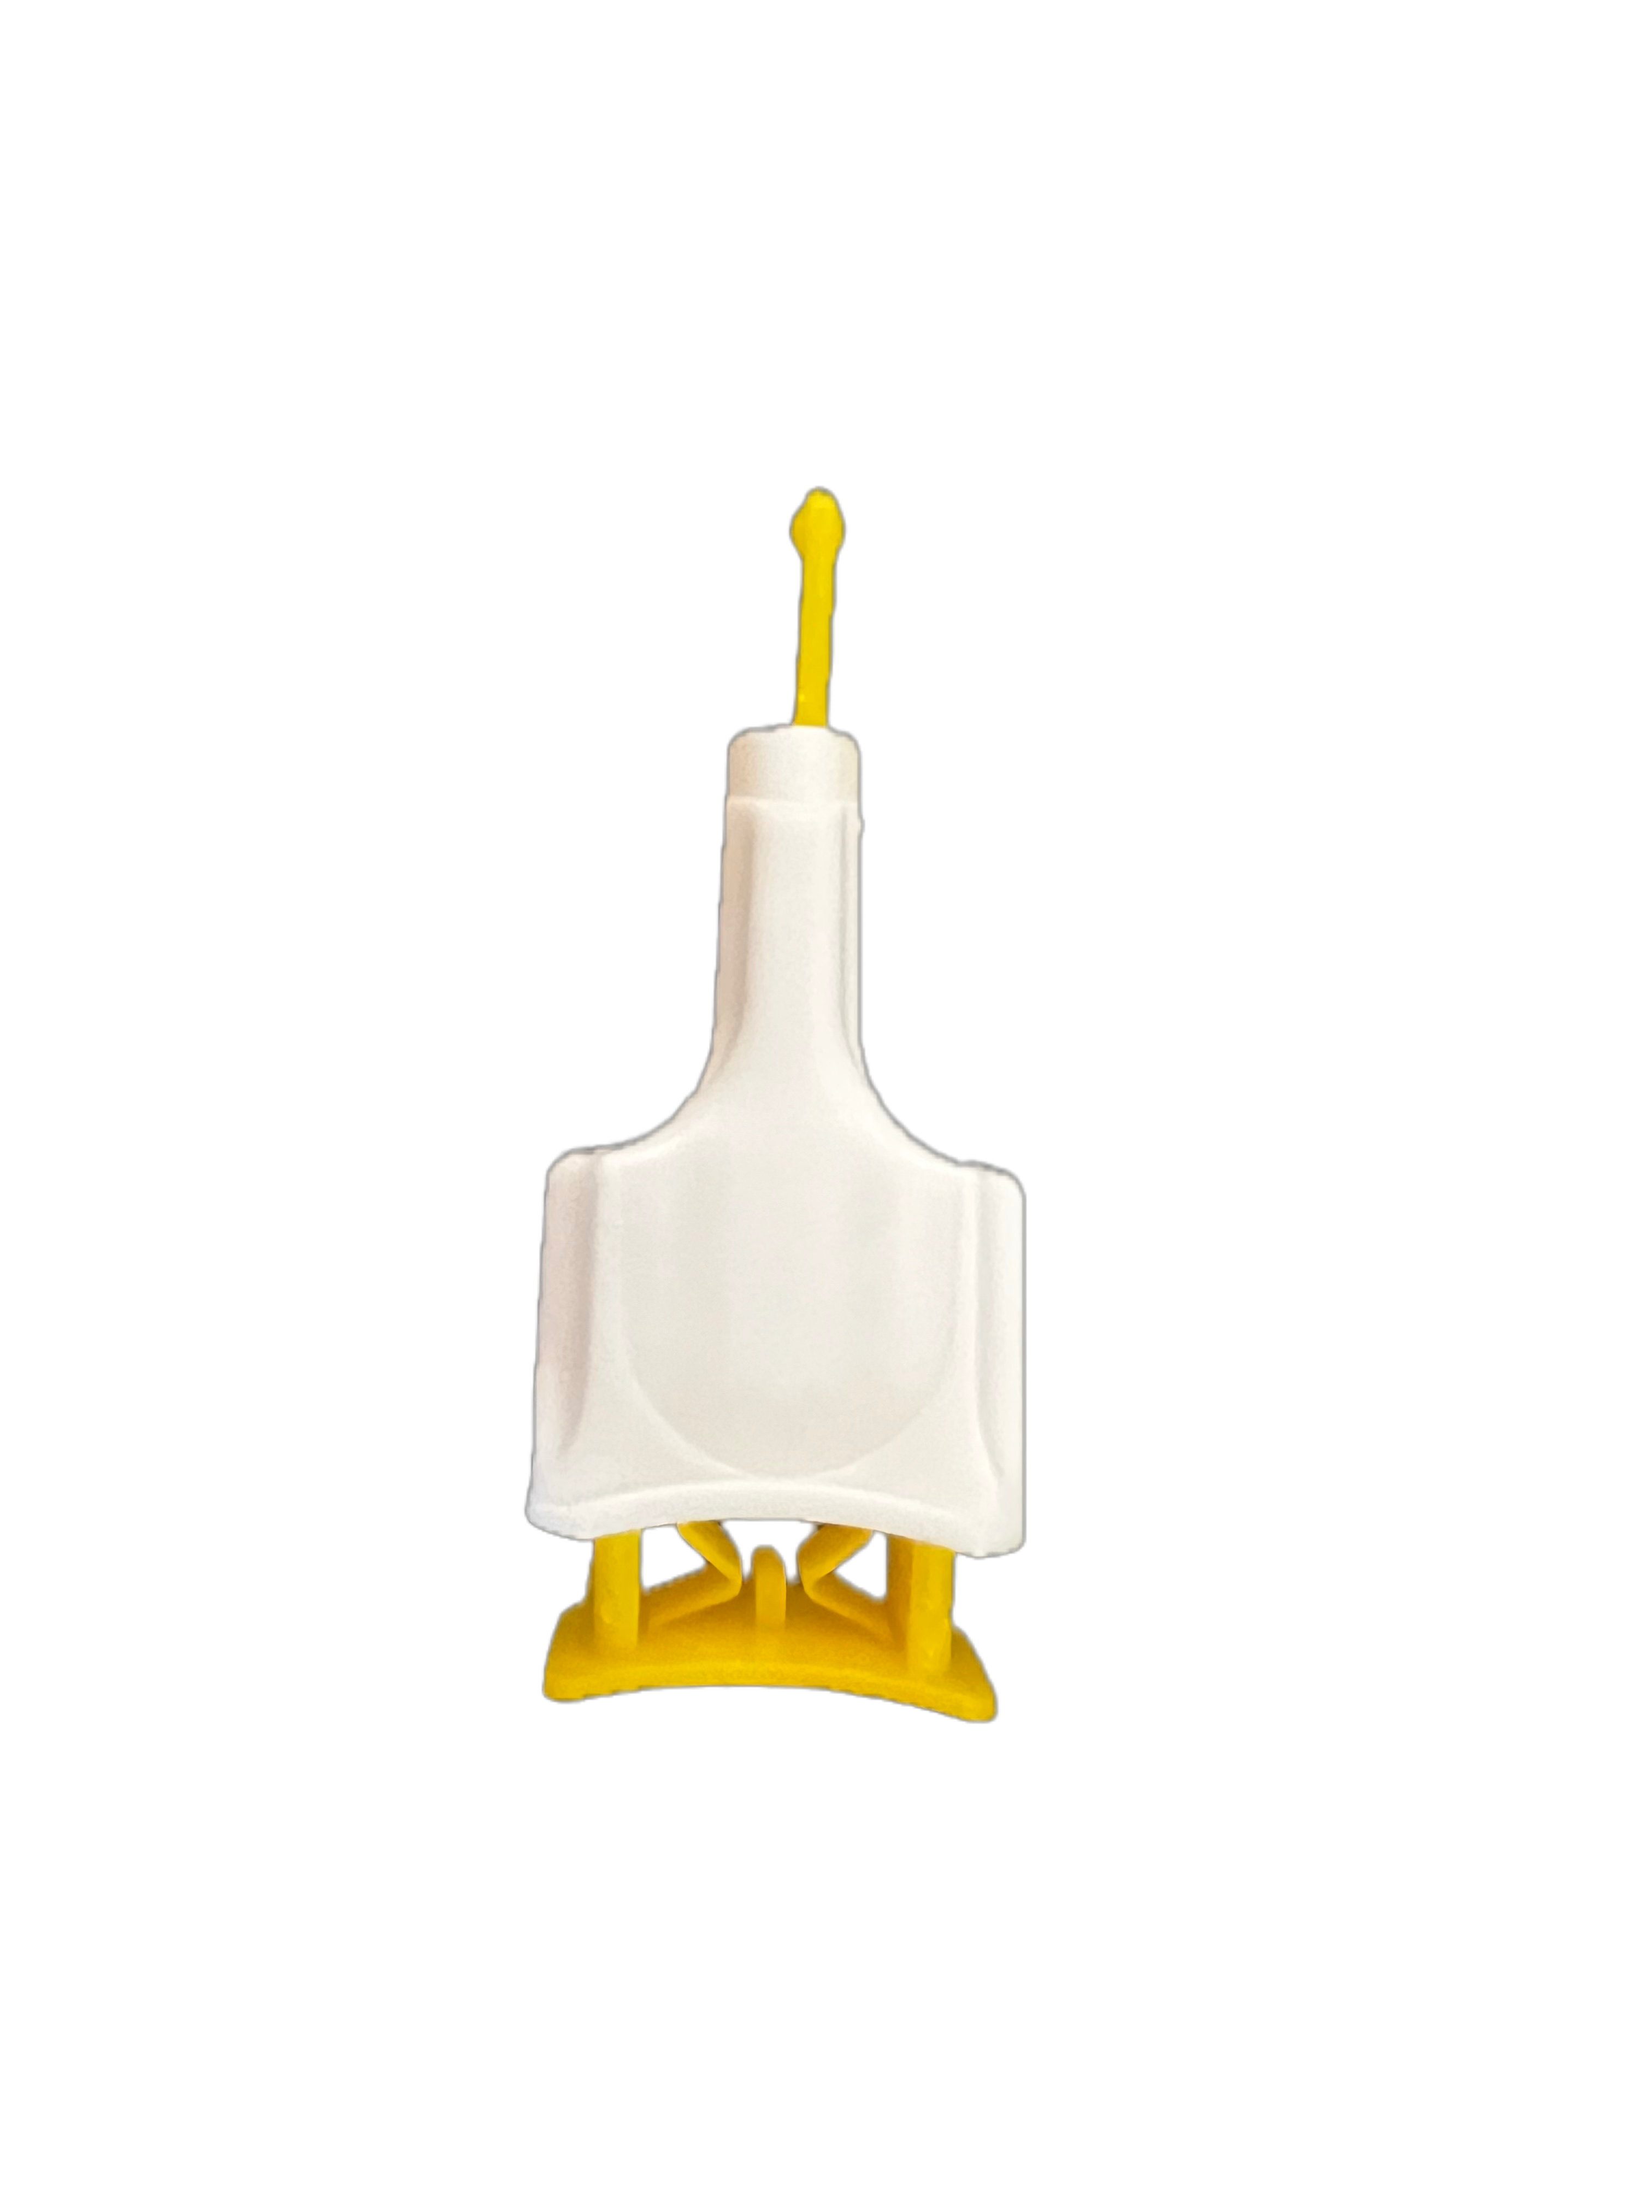
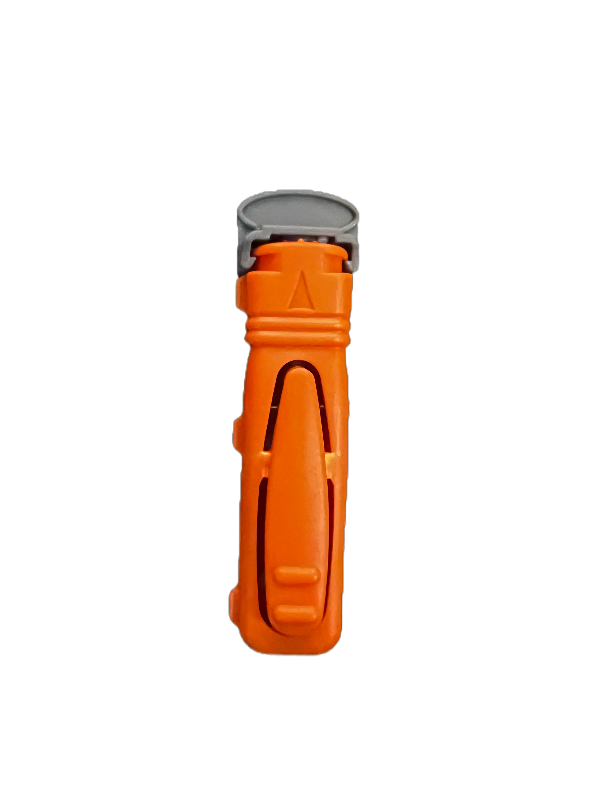
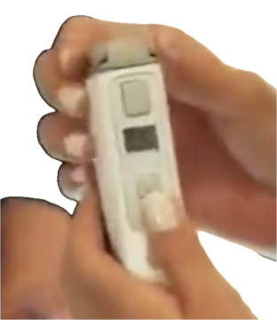
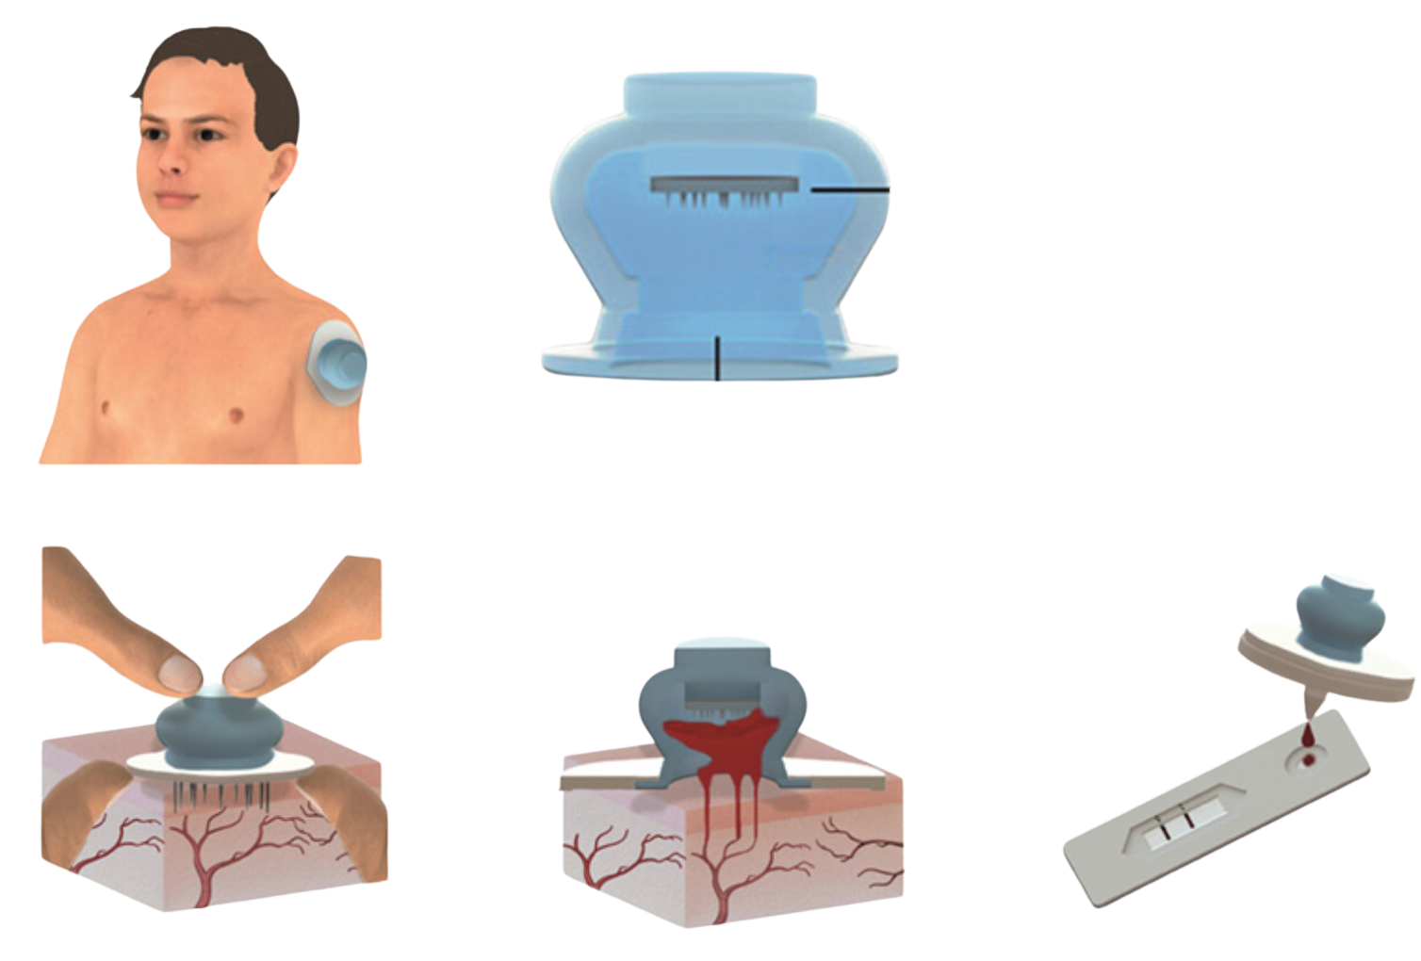
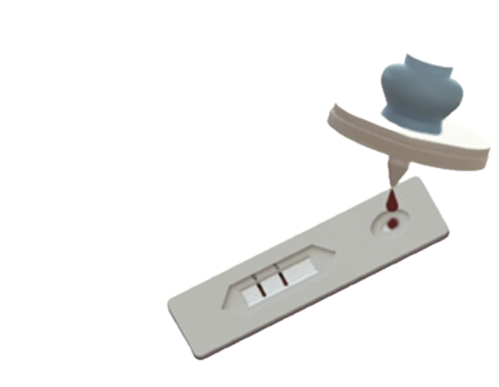
Lancet: Research
LANCET TYPES
NEW TECH
Pressure-activated
Genteel (USA)
Press on finger — fires automatically
Vacuum + vibration, no squeezing. FDA-cleared, reusable.
Push-button
WATCH
Product Rsrch
Remove tab, press button
Side-button
Press side trigger — least intuitive
ERBILITE laser (NSL, Moscow)
Laser lances the finger. needle-free, 6 depth levels. Clinic device.
WATCH
Microneedles
Leech-style suction cup (ETH Zurich)
Suction Cup
Suction + ~12 microneedles, ~195 µL (animal). Seeking partners.
INNOVATION CANDIDATE
Product Rsrch

Slide 2
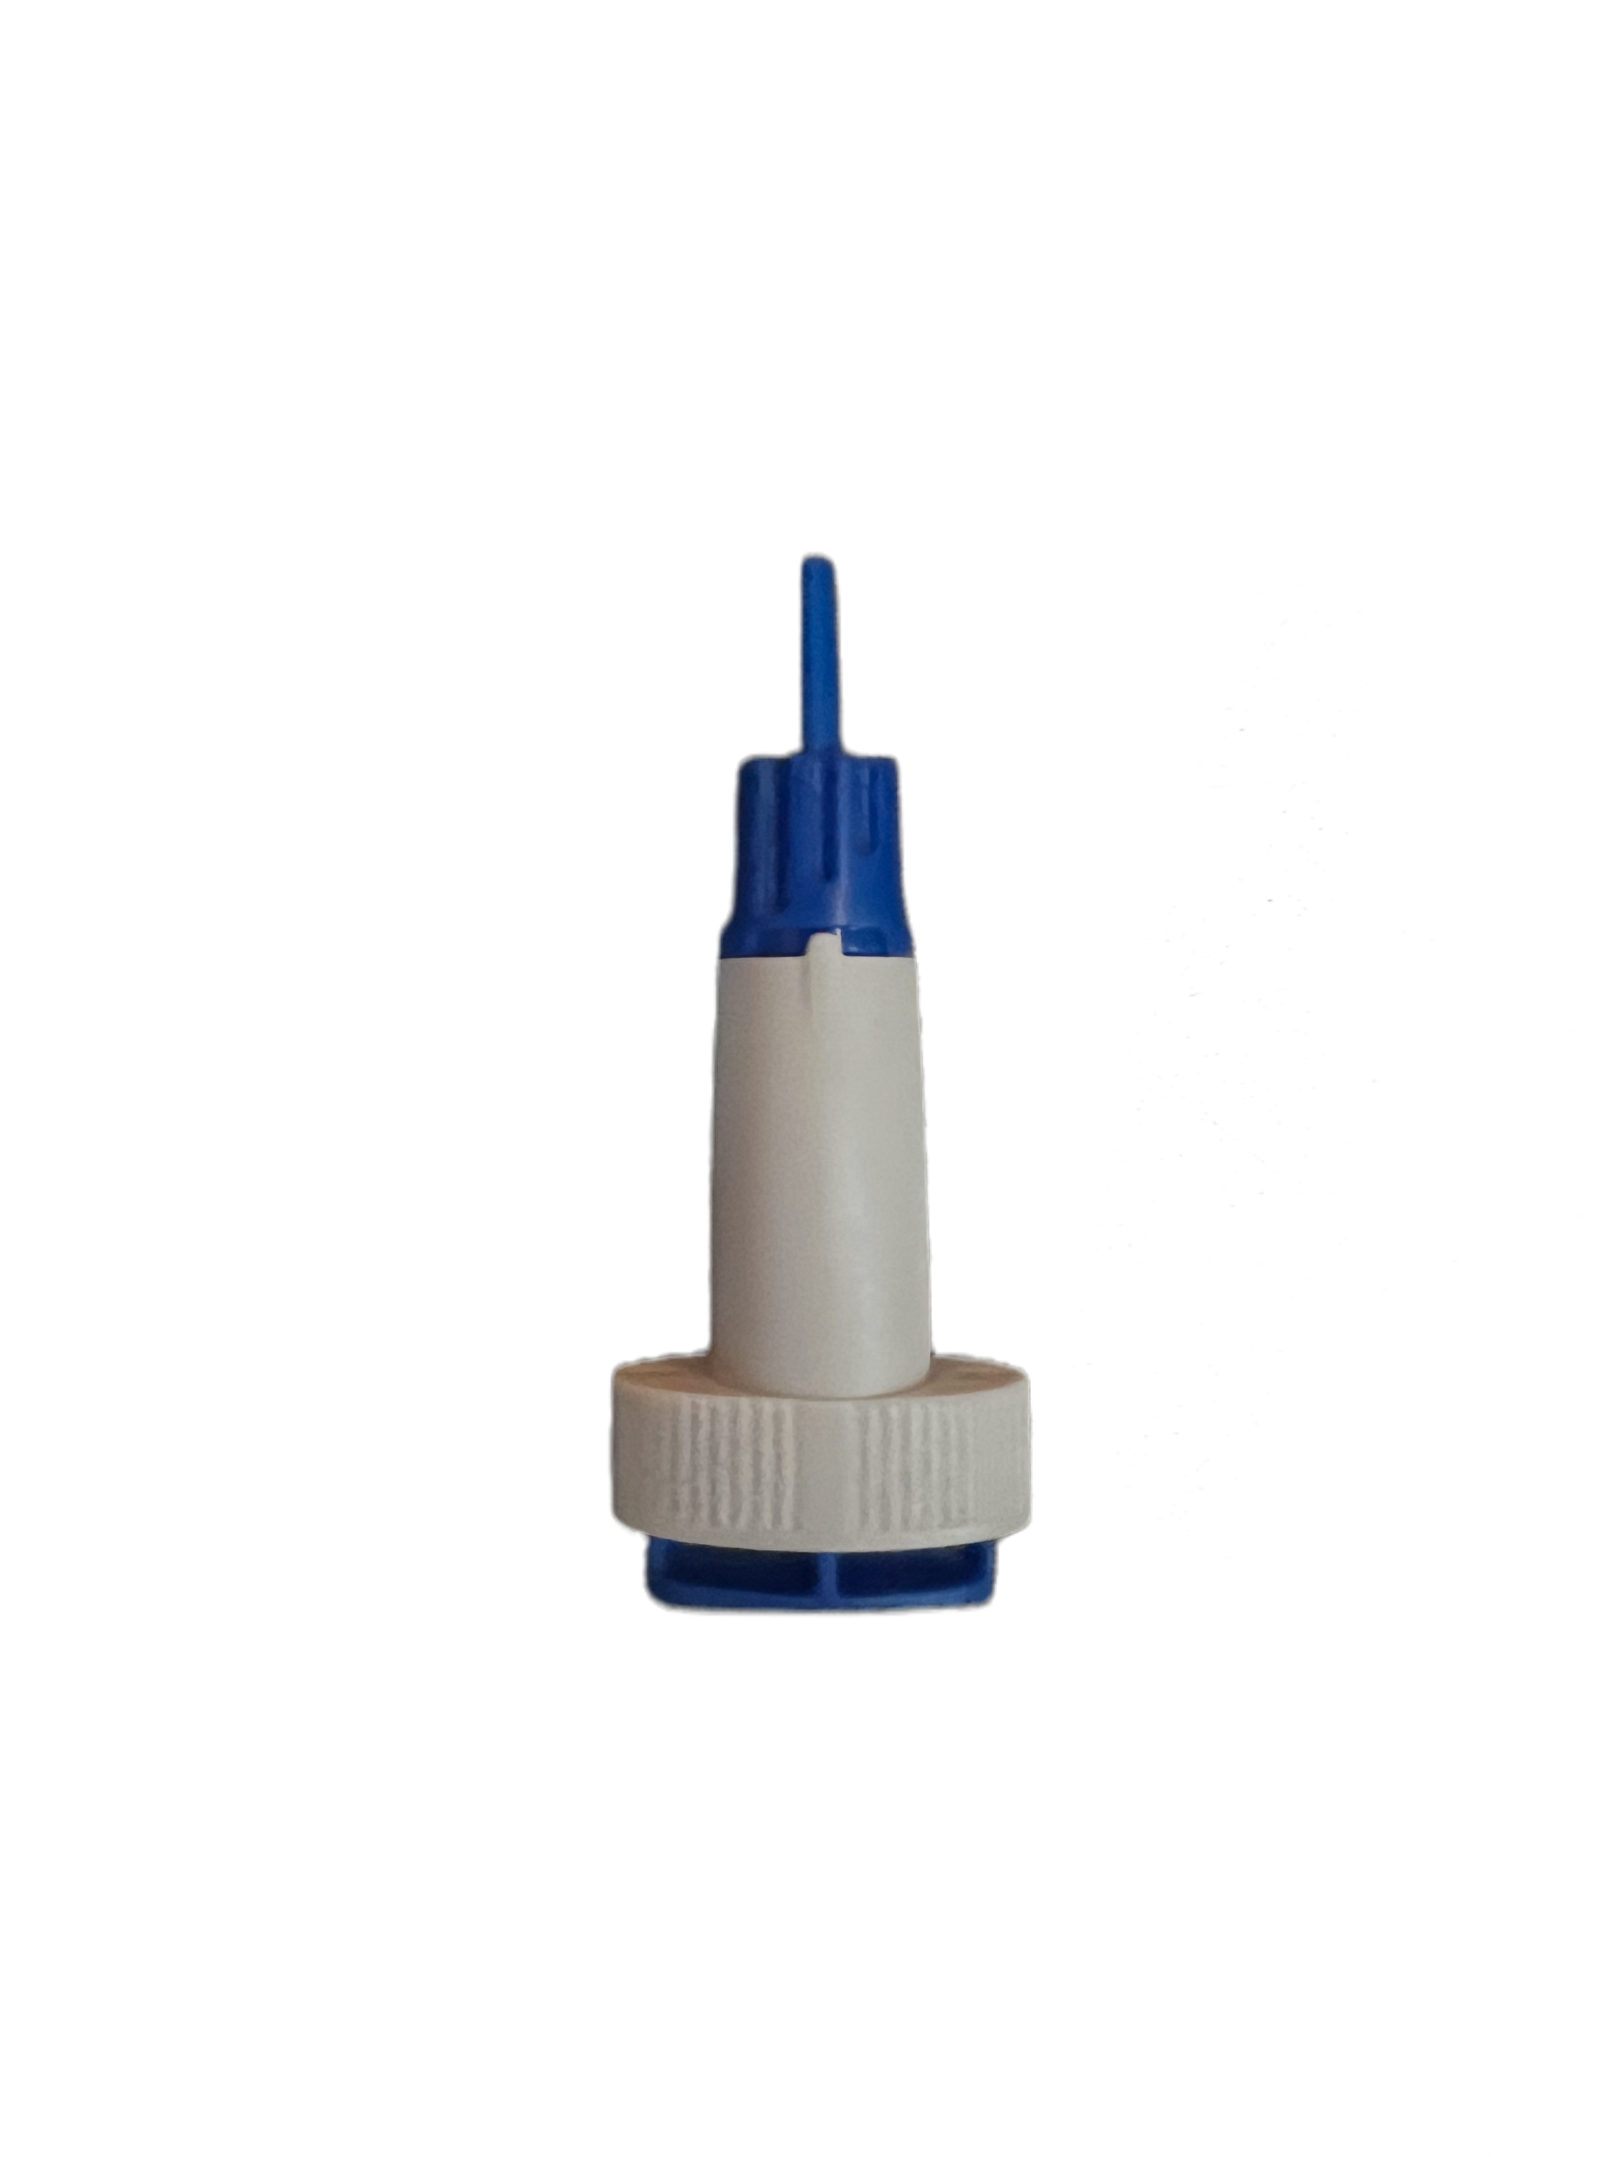
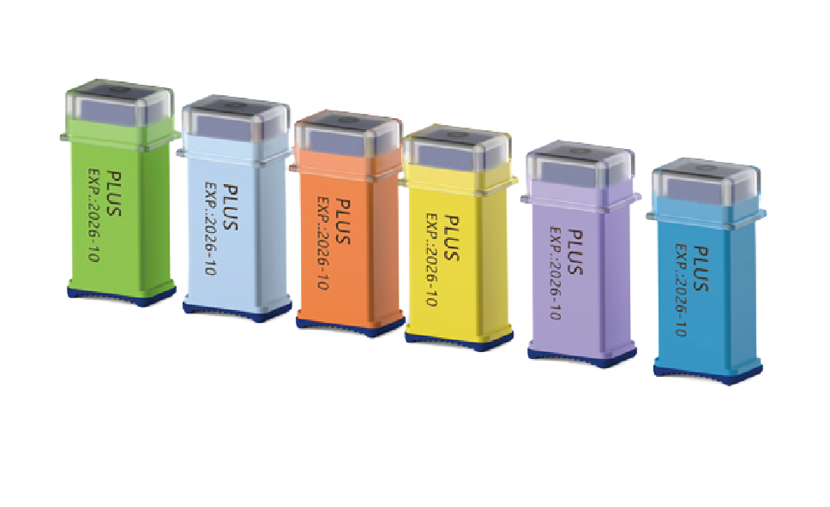
Lancet: Top Contenders
30G × 1.8
28G × 1.8
26G × 1.8
23G
21G × 2.0
lowest pain
most blood
Unistik 3 Extra
Accu-Chek Safe-T-Pro Uno
Accu-Chek Safe-T-Pro Plus
SteriLance NEW
Maker
Owen Mumford, UK
Roche
Roche
SteriLance, China (OEM)
dsmedical.co.uk
apollopharmacy.in
midmeds.co.uk
en.sterilance.com
Gauge × depth
21G × 2.0 mm
pre-set 1.5 mm
23G, 1.3 / 1.8 / 2.3 mm
23–30G × 1.8 mm
Activation
Side button
Push button
Push button, adjustable
Pressure + button
Est. price/pc
₹11
₹5–9 (est.)
₹15–25 (est.)
₹3–6 (est.)
Product photo

Slide 3
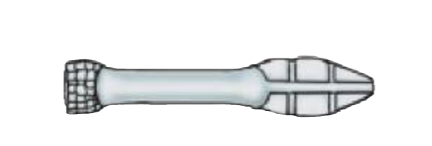
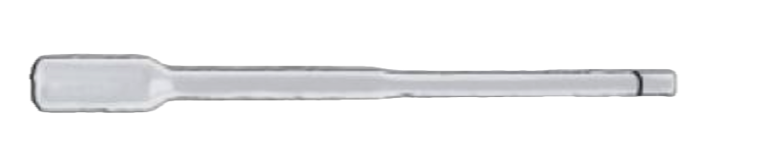
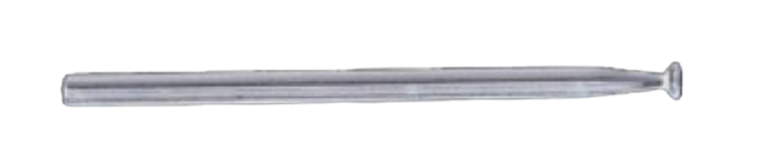
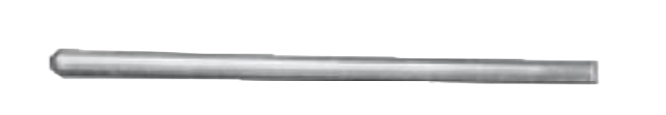
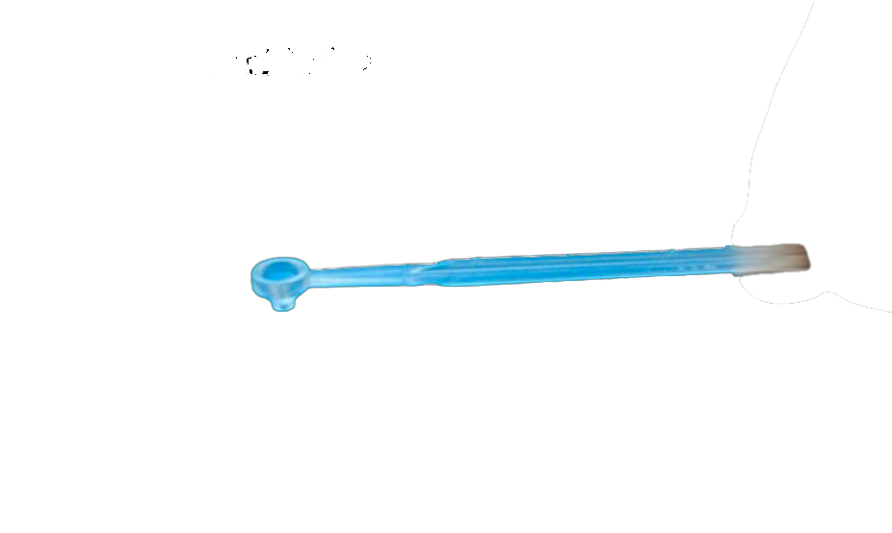
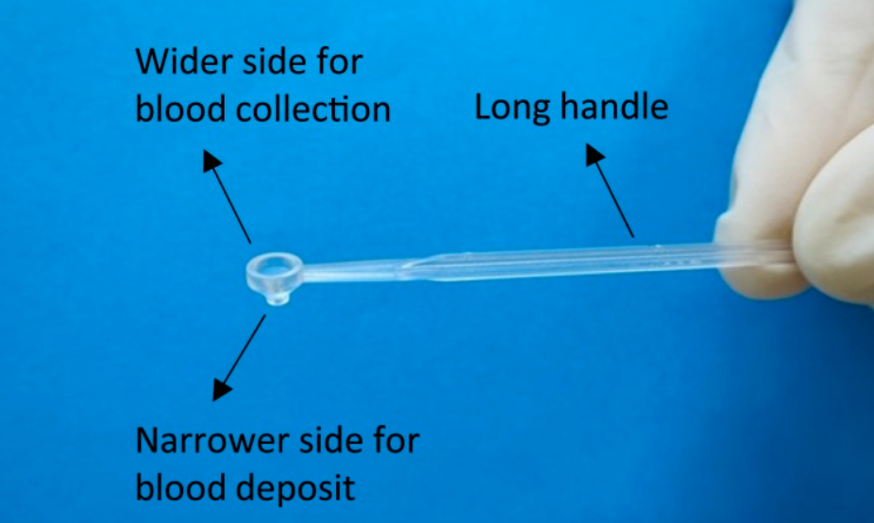
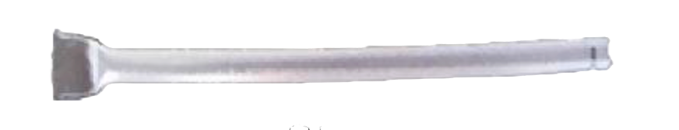

Blood Transfer: 7 Device Types
Squeezable pipette
Inverted cup
Calibrated pipette
Capillary tube
Manual
Automatic
Semi
Semi
User controls volume
5 µL, 170M+ in malaria kits
Fill to the mark
Users underfill
space for photos
Straw
Loop
Conical cup TOP
Manual
Manual
Automatic
Draw and blow out
Picks up a droplet
~23 µL, 92% vs 74% fill

Slide 4
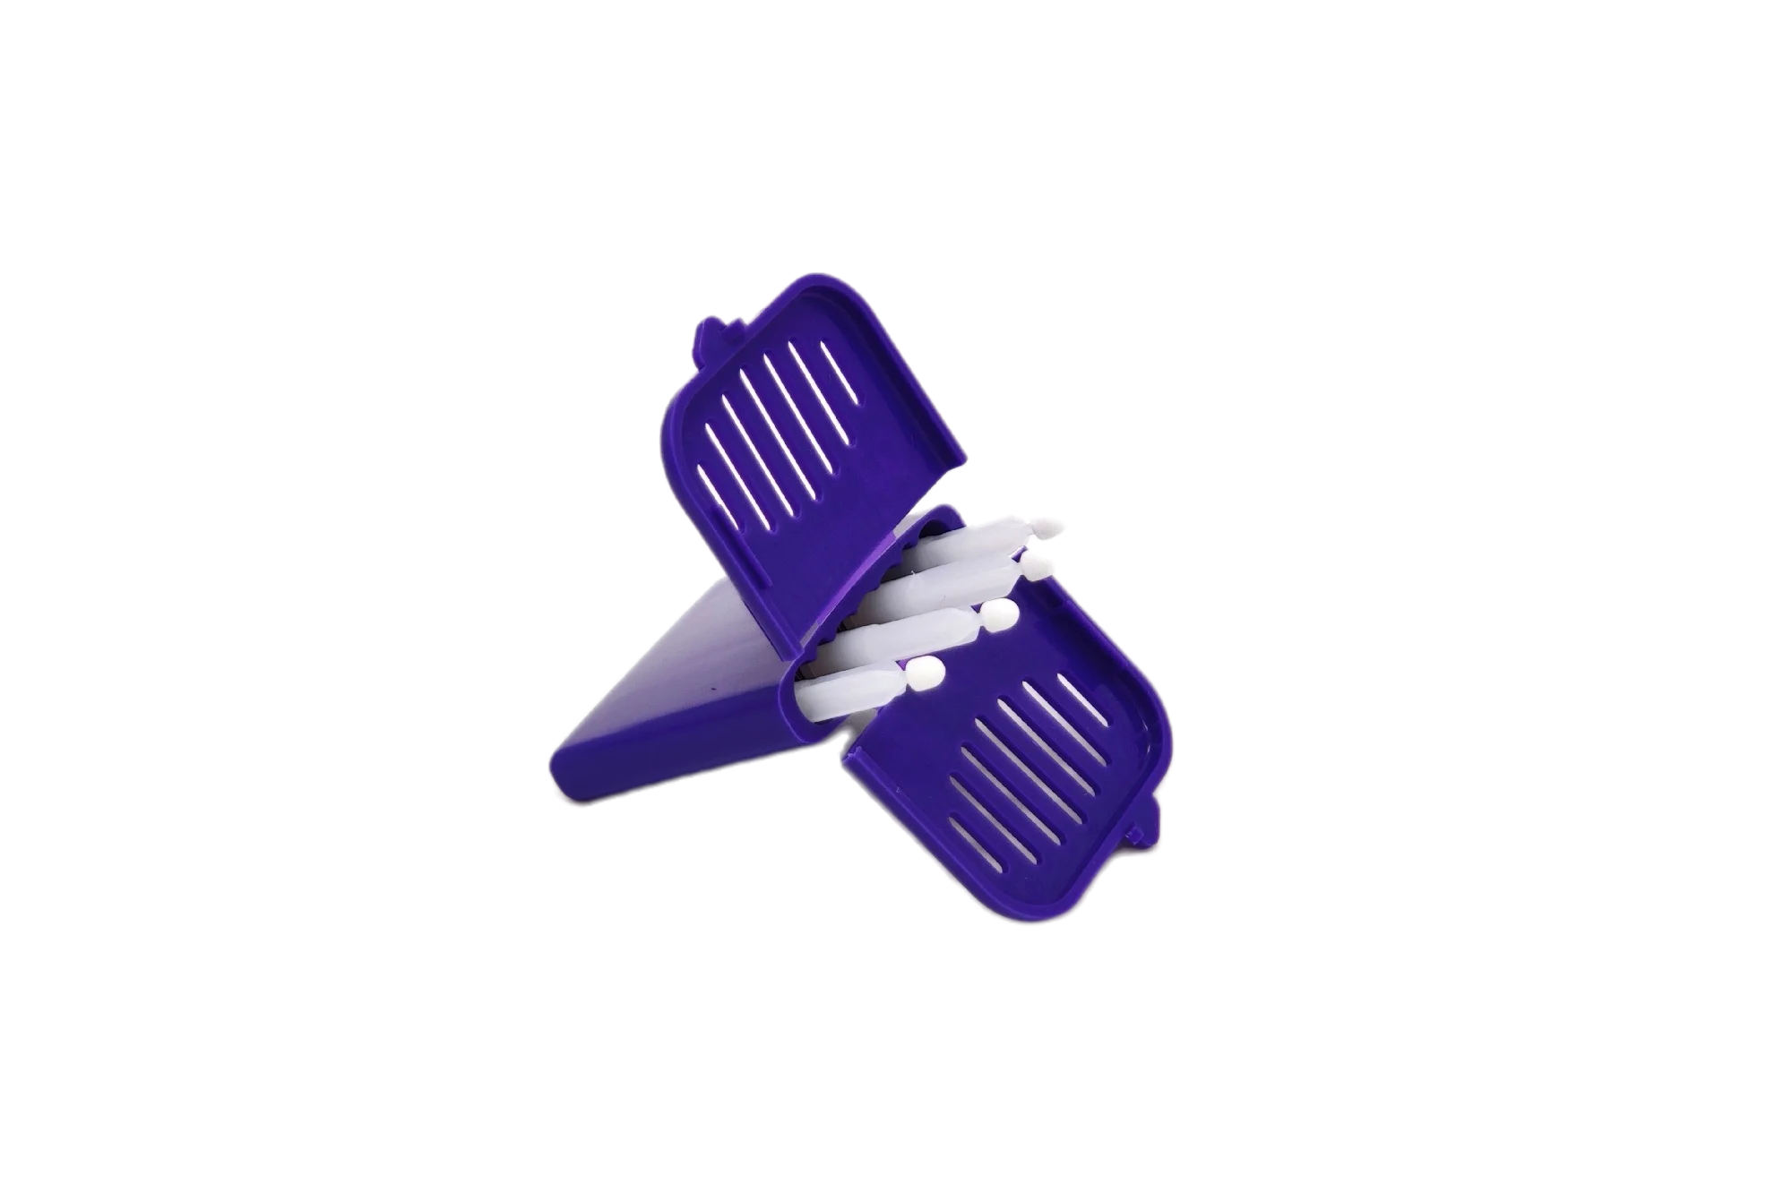
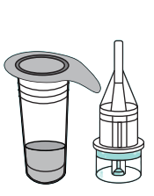
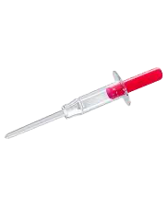
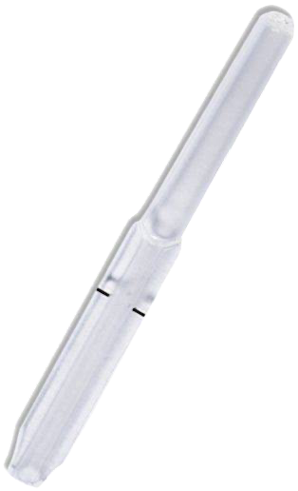
Pipette: Top Contenders
01
02
03
04
05
Conical Cup
UniSampler-type
Minivette POCT
Microsafe
Absorptive tip
FIND
Affimedix / generics
Sarstedt
Safe-Tec
Mitra, Trajan
~23 µL capillary
Touch-to-fill
Fixed volume
Locks into vial
10–200 µL
Piston + stop filter
Fixed volume
One-piece, drop-free
10–30 µL in 2–4 s
pmc.ncbi.nlm.nih.gov
Affimedix
sarstedt.com
cliawaived.com
neoteryx.com
NEW
LAUNCH
BENCHMARK
BENCHMARK
NEW TECH

